Slide 1
Project Title: Brain Tumor Detection using CNN
Project Guide
Mr. K. Ananda Kumar
M.tech , AMIE(CSE)
Associate Professor
CSE-AI & ML
Head of the Department
Dr. B. Kiran Kumar .Ph.D.
Professor & HOD
CSE- AIML & IoT

Slide 2
Team Members
GROUP MEMBERS ROLL NO’S
VAKKALANKA AKHIL 20MH1A4261 GOODUPU VENKATA VAMSI KRISHNA 20MH1A4211 GUBBALA VINAY KUMAR 20MH1A4214 DUDI USHA SREE 20MH1A4258 BOLLINA YUVA SIVA RAMA KRISHNA 20MH1A4205

Slide 3
01
Data Collection and Pre-Processing analysis

Slide 4


Research and
Data Collection
Data Collection

Slide 5



Data Pre-Processing analysis
1) Rotation
2) Flipping
3) Scaling
Data Pre-processing

Slide 6
02
Data set Organization

Slide 7

Data Set
Feature | Description
Focus | Glioblastoma (GBM/HGG) & Lower Grade Glioma (LGG)
Imaging Modalities | T1, T1Gd, T2, T2-FLAIR
Spatial Resolution | Interpolated to 1 mm³
Associated Competition | Part of MICCAI 2020 Conference
Challenges | Segmentation, OS prediction, uncertainty evaluation

Slide 8

Data Set
Annual MICCAI event since 2012, dedicated to automated brain tumor segmentation.
Large-scale public datasets, hosting thousands of MRI scans and enabling fair comparison of techniques.
Attracts hundreds of global participants yearly, accelerating advances in diagnostics and personalized care.

Slide 9
03
Data Segmentation

Slide 10
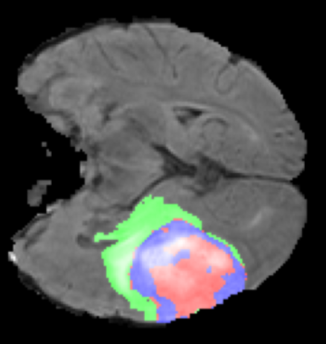
Data Segmentation
Data segmentation is the process of partitioning medical imaging data, such as MRI or CT scans of the brain, into meaningful segments or regions. In brain tumor detection, segmentation involves identifying and delineating tumors or regions of interest from surrounding tissues.
Accurate segmentation plays a pivotal role in diagnosis, treatment planning, and monitoring of brain tumors. It provides crucial spatial information about tumor location, size, and shape, aiding clinicians in making informed decisions about patient care.
Traditional segmentation methods, such as thresholding and region growing, have been supplemented by advanced approaches like deep learning-based segmentation using convolutional neural networks (CNNs). These methods offer improved accuracy and robustness in segmenting brain tumors from complex medical imaging data.

Slide 11
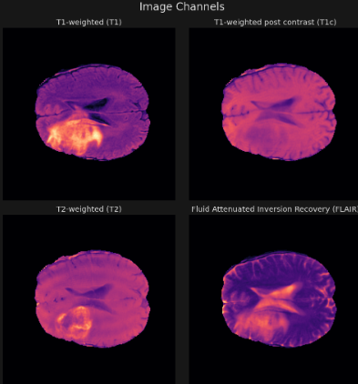
Segmentation Channels

Slide 12
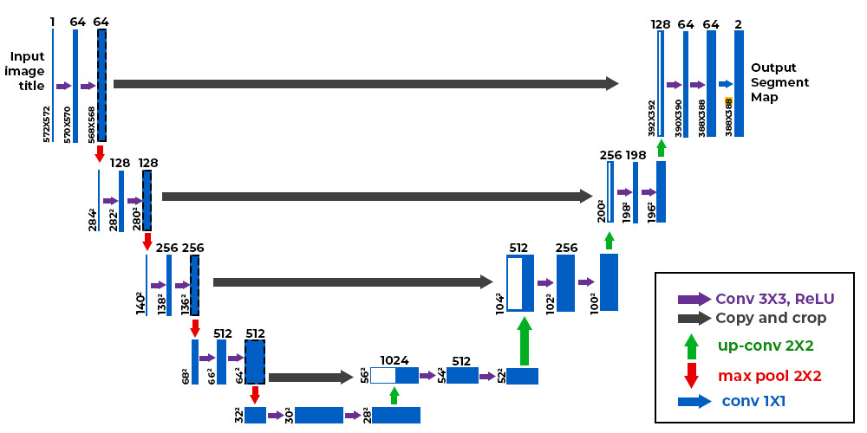
Segmentation Architecture

Slide 13
04
Data Classification

Slide 14
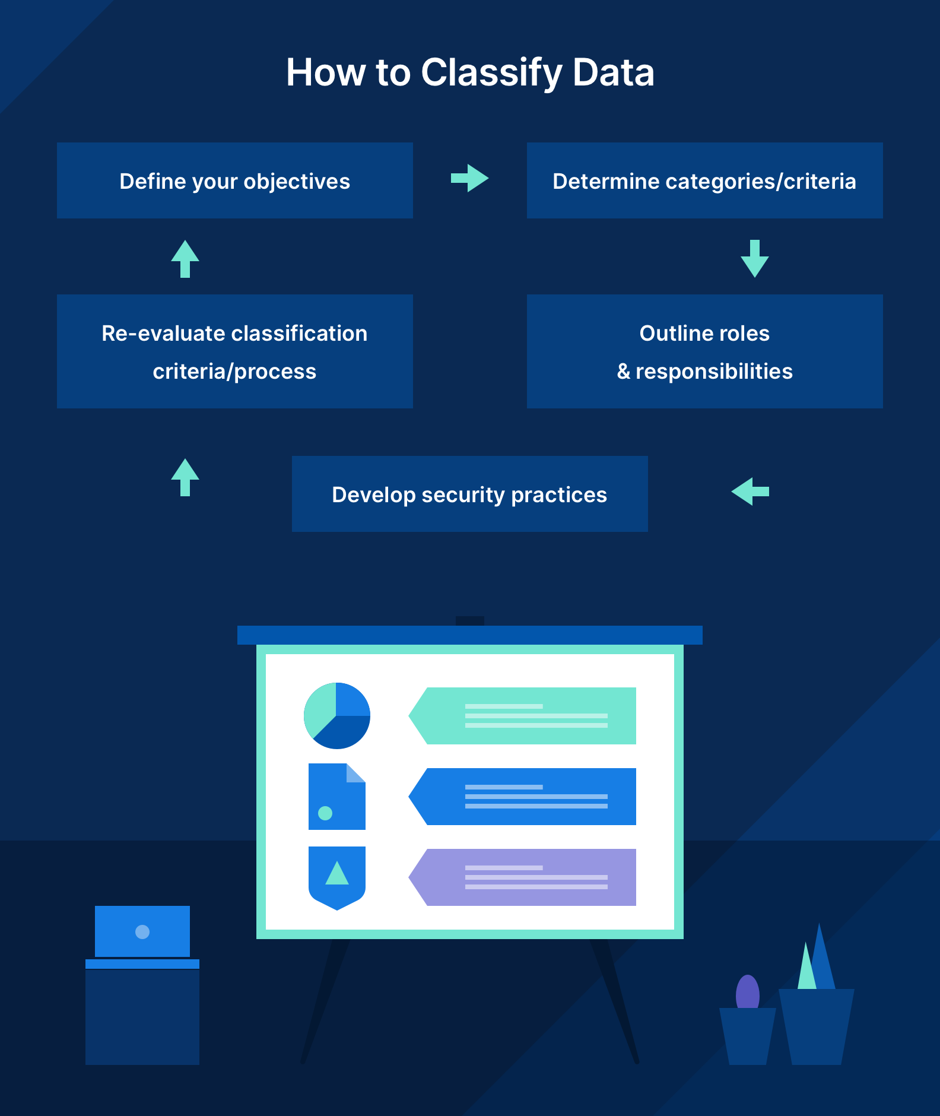
Data Classification
Data classification is the process of categorizing data into distinct groups or classes based on specific criteria or attributes. The primary objective of data classification is to organize and label data according to its characteristics, making it easier to manage, analyze, and utilize for various purposes.
Classification involves assigning predefined labels or categories to data instances, enabling automated decision-making, pattern recognition, and information retrieval.
This process is fundamental in various domains, including machine learning, data mining, information retrieval, and database management, where data classification facilitates tasks such as predictive modeling, pattern recognition, and knowledge discovery.

Slide 15
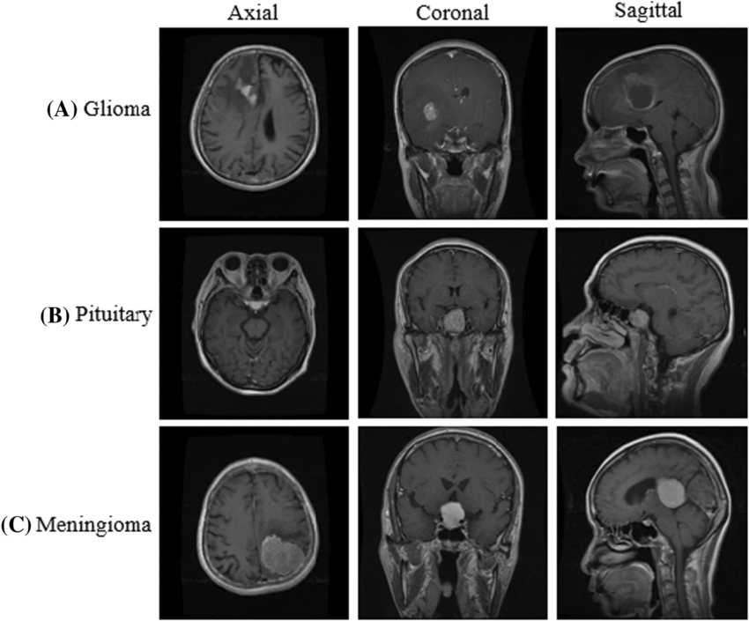
Types of Tumors

Slide 16
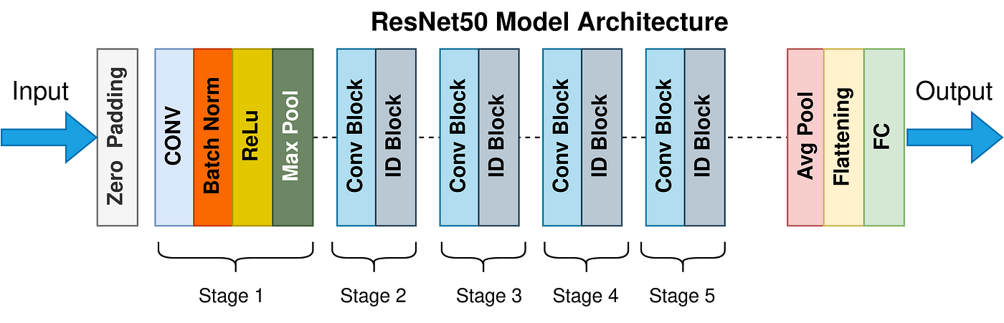
Classification Architecture

Slide 17
05
Model Testing & Front-end

Slide 18
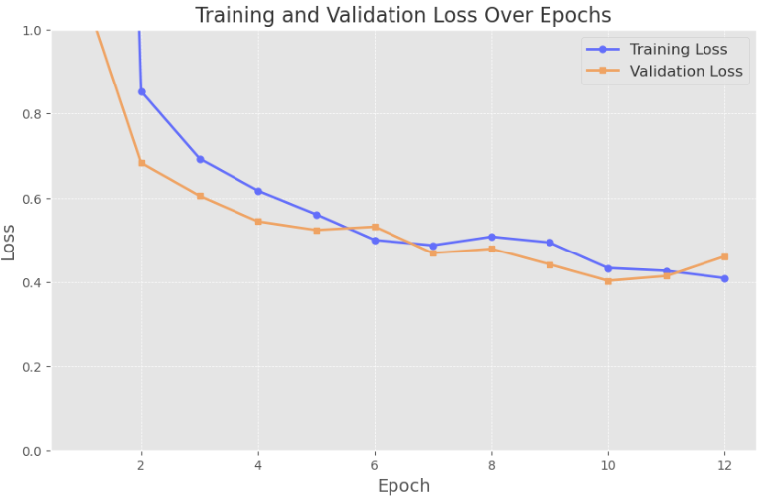
Model Testing

Slide 19
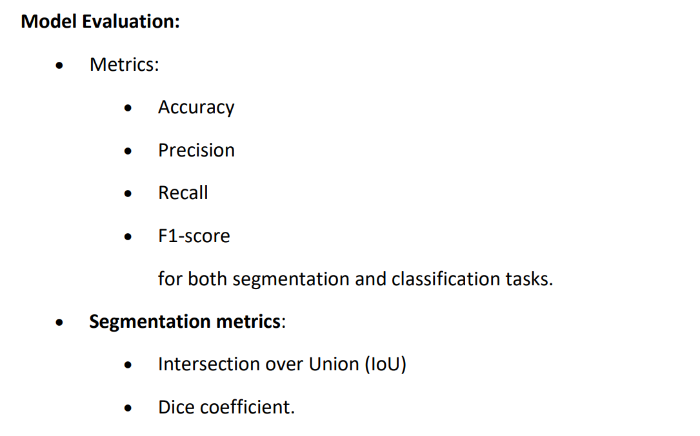
Model Testing

Slide 20
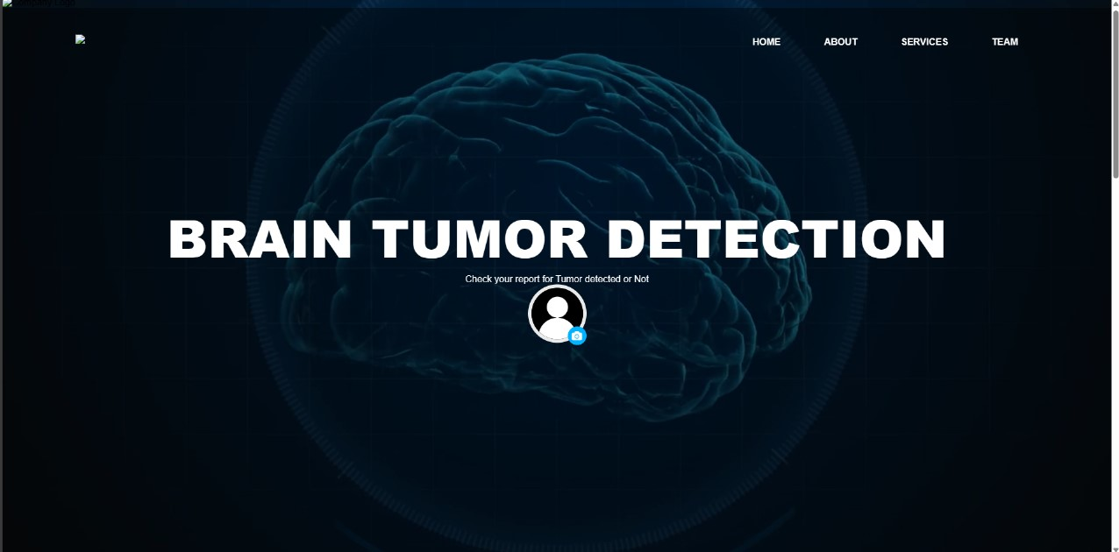
UI(User Interface)

Slide 21
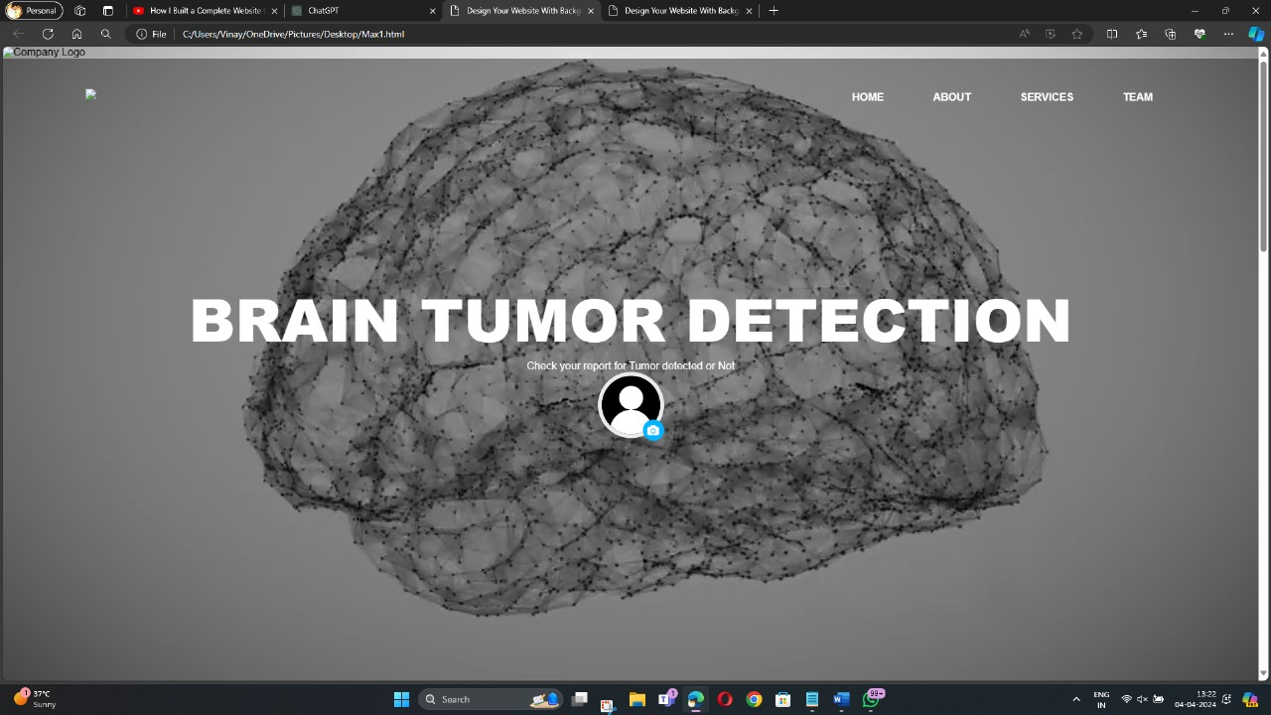
UI(User Interface)

Slide 22
Thank You!

